Slide 1
TrueSite Workstation Version 6.03 : In-Depth
Technical details on the hardware, software, programming and configuration for this launch
Product Launch Presentation
May, 2022
23-Feb-17

Slide 2
TSW 6.03 Features

Slide 3
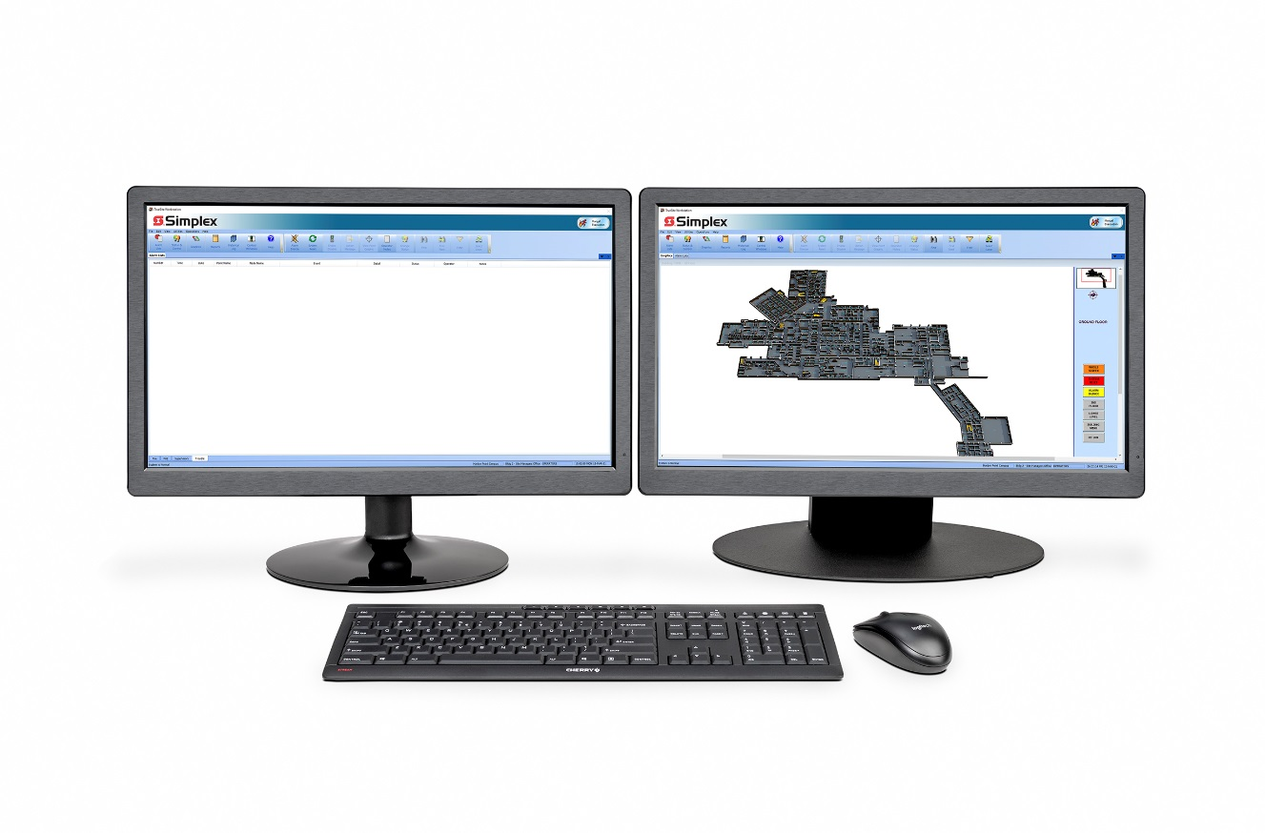
New Features
Graphics
Graphics folder tree vs pull-down menu
TSW Runtime Load Graphic
Layer Control
Updated Graphic Icons
Using Buttons for Icons
TSW Configurator Preferences
Site Info
DACR Support
DACR: SIA Level 2 Protocol (SIA2)
Trigger Licenses
Trigger License type support for secure customer sites
TSW Topology and Attendance
TSW Runtime Topology and Attendance screens
Notes:
Mention product benefits and the value to our customers

Slide 4
New Features
Remote Client
TSW invokes remote client connections to other TSWs on the same network
Command Line Support
Support for event printing at Remote Client
Language Support
Language support for Traditional Chinese
Miscellaneous
Official support for TSW to use an NTP time server
UL 2610 Compliance (Standard for Commercial Premises Security Alarm Units and Systems)

Slide 5
Sotware Highlights

Slide 6
New Software
Software
The following TSW software has been updated:
TrueSite Workstation Configurator
TrueSite Workstation Graphics Editor
TrueSite Workstation Server Software
TrueSite Workstation Remote Client Software
ES Net Diagnostic Tool

Slide 7
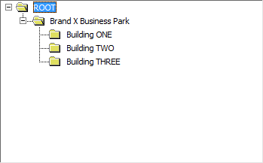
Graphics Folder Tree – Manage Documents
Screens can be organized in folders/subfolders that are visible within the Graphics Editor and Runtime application
Useful in jobs with many screens
Replaces the single listing layout of the previously used pull down menu
By default, all existing/upgraded screens are placed in the folder ROOT
Folders are created in the new Manage Documents window

Slide 8
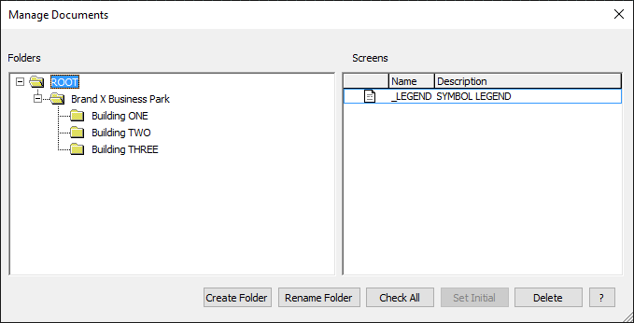
Graphics Folder Tree – Manage Documents
Folders are created/renamed in the new Manage Documents window
Each folder level can contain up to 100 sub-folders
No direct limitation on the number of folder levels
Job is limited to a combined total of 1000 folders and sub-folders
Sub-folder are created within the selected/highlighted folder
Renaming a folder does not affect its contents

Slide 9
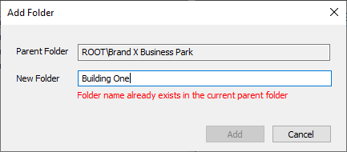
Graphics Folder Tree – Manage Documents
Folder names must be unique within each sub-folder
Folder names specifications:
Can be 40 characters max
Spaces and other special characters
Cannot contain only spaces
No leading or trailing spaces
If the current parent folder already contains a folder with the same name, an error message is displayed (red arrow)
Folder names for each job are stored in the TSW job folder in a file called folders.doc
If the folders.doc file becomes missing or corrupted, all screens fall back to the folder ROOT

Slide 10
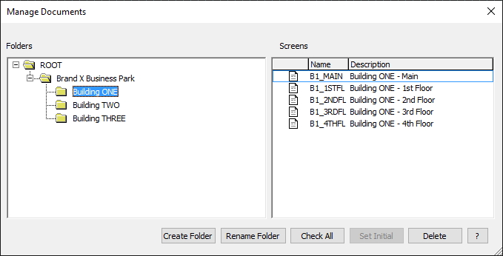
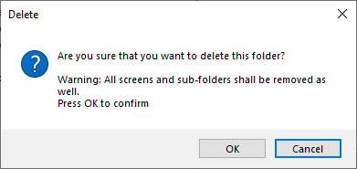
Graphics Folder Tree – Manage Documents
When a folder is selected/highlighted, the graphic file content is displayed in the right pane (red arrows)
Locations of existing folders, sub-folders and graphic files can be moved using drag and drop sequence
Deleting a folder will removes the folder and all its contents
Graphic files will be deleted, not moved to the folder ROOT (green arrow)

Slide 11
Graphics Folder Tree – Manage Documents
Folder names must be unique within each sub-folder
Folder name specifications:
Can be 40 characters max
Spaces and other special characters
Cannot contain only spaces
No leading or trailing spaces
If the current parent folder already contains a folder with the same name, an error message is displayed (red arrow)
Folder names for each job are stored in the TSW job folder in a file called folders.doc
If the folders.doc file becomes missing or corrupted, all screens fall back to the folder ROOT

Slide 12
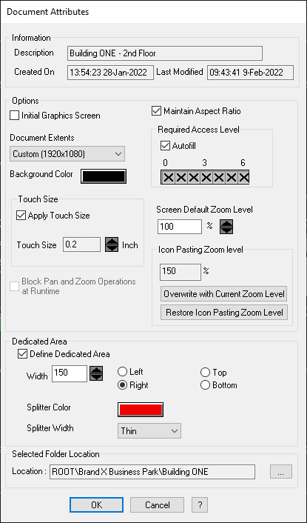
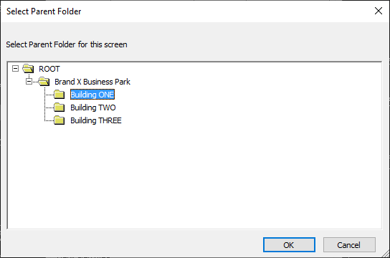
Graphics Folder Tree – Document Attributes
When a New screen is created, it’s placed in the last-used folder location by default or the folder ROOT if there are no folders within the job
Document Attributes dialog now contains folder location (red arrow)
Click the …. button to change the folder location for the current screen (green arrow)
Graphics Editor “Attributes” dialog

Slide 13
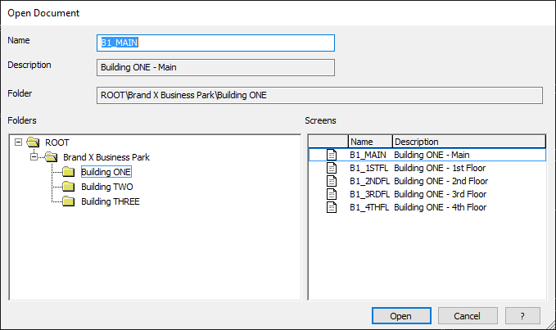
Graphics Folder Tree - Open Document
UPDATED Open Document Dialog
New File/Open dialog shows folders/sub-folders
Right pane only displays contents of selected/highlighted folder
By default, last remembered location will be highlighted
Select the desired folder (red arrow)
Double-click on the screen’s name or highlight a screen then click Open (green arrow)
Updated File/Open dialog

Slide 14
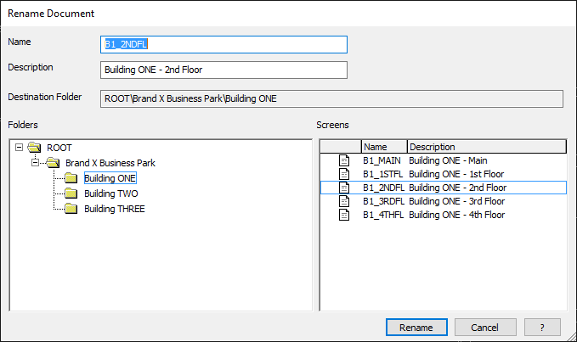
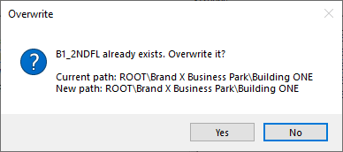
Graphics Folder Tree - Rename Document
NEW Rename Document dialog
Updated to a folder structure
Ability to rename screens and move to other folders
The folder ROOT cannot be renamed
Rename screen to a unique name; otherwise, a warning appears (red arrow)
All screens in TSW job must have unique names
The file description can be reused
Description cannot be empty, but it is ok to use spaces
Renaming folders are done via the Manage dialog

Slide 15
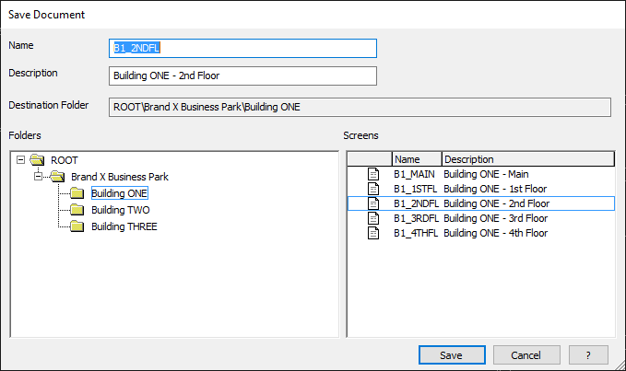
Graphics Folder Tree - Save Document
New Save-As Dialog
When the user selects Save-As, by default it highlights the last remembered folder location
User can choose a different location
When the Save button is clicked, the Graphic file will be saved in the selected/highlighted folder
Updated Save-As Dialog box

Slide 16
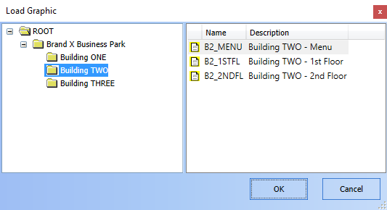
TSW Runtime Load Graphic
NEW TSW Runtime Load Graphic Dialog
When Load graphic button is clicked:
Instead of a simple pull-down menu, folders and sub-folders are displayed
Select folder and then double-click to open Graphic file
Layout determined in the TSW Configurator’s Manage menu
Cannot edit, rename, delete, or move folders and graphic files while in Runtime

Slide 17
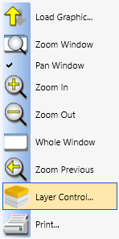
Layer Control
New menu item added to the Runtime Graphics Menu and Menu Bar (red arrows)
Layer Control menu item allows the user to actively hide/show individual layers of the current graphic screen
Option available for TSW Feature V6.03+

Slide 18
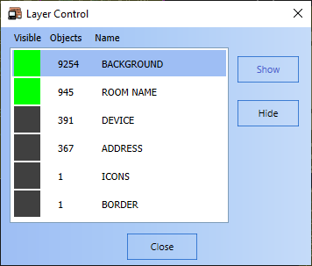
Layer Control
Selected the layer to be changed (red arrow)
Then click Hide or Show (green arrow)
If the operator chooses to hide the last visible layer, a warning will appear (Blue arrow)
Note:
Any layer changes are saved/remembered within a given TSW Runtime session
Any changes will not be reflected in the Graphics Editor
Not saved in the next TSW Runtime instance on a given PC
Changes made in the TSW Server will not be reflected in the Remote Clients and vice versa
Runtime Graphics - Layer Control Menu

Slide 19
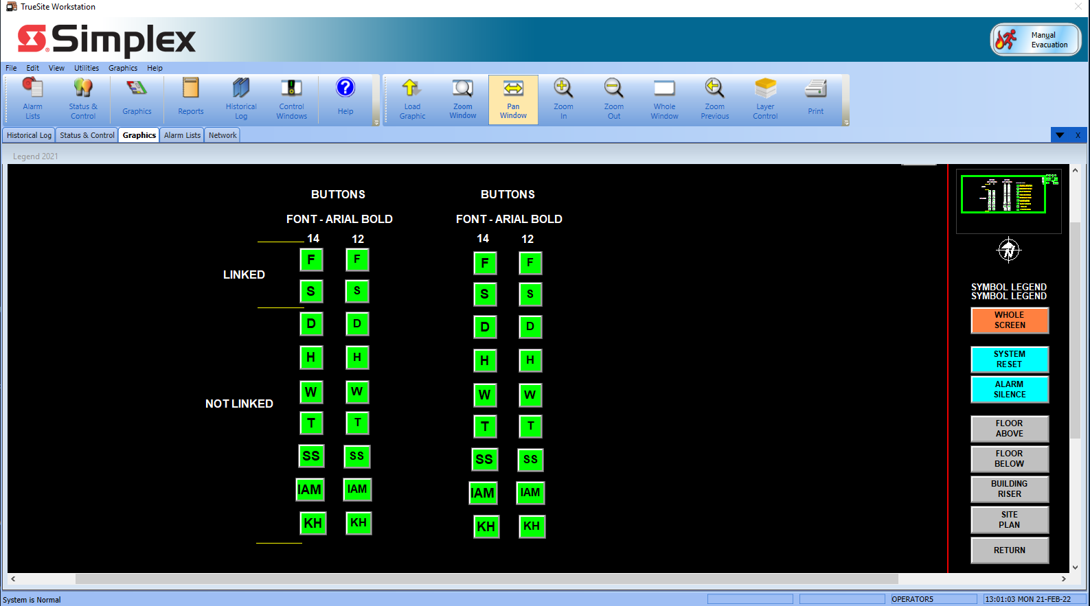
Updated Graphics Icons
TSW Graphics Legend – Graphics Editor Button Icons
Updated, more appealing button icons
New legend with button style icons (to be used on 3D screens)
Updated Legend with Button Icons

Slide 20
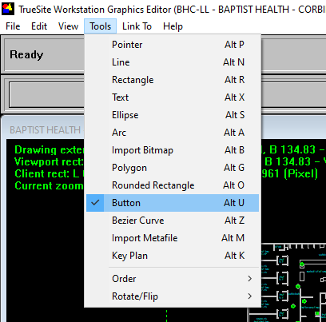
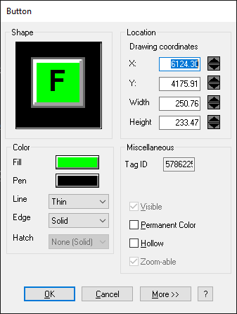
Updated Graphic Icons
Graphics Editor Tools Menu (Button)
The existing Button dialog has been updated to allow buttons (aka “Command Links”) to center text that only has one letter
Existing Graphics Editor Tools Menu

Slide 21
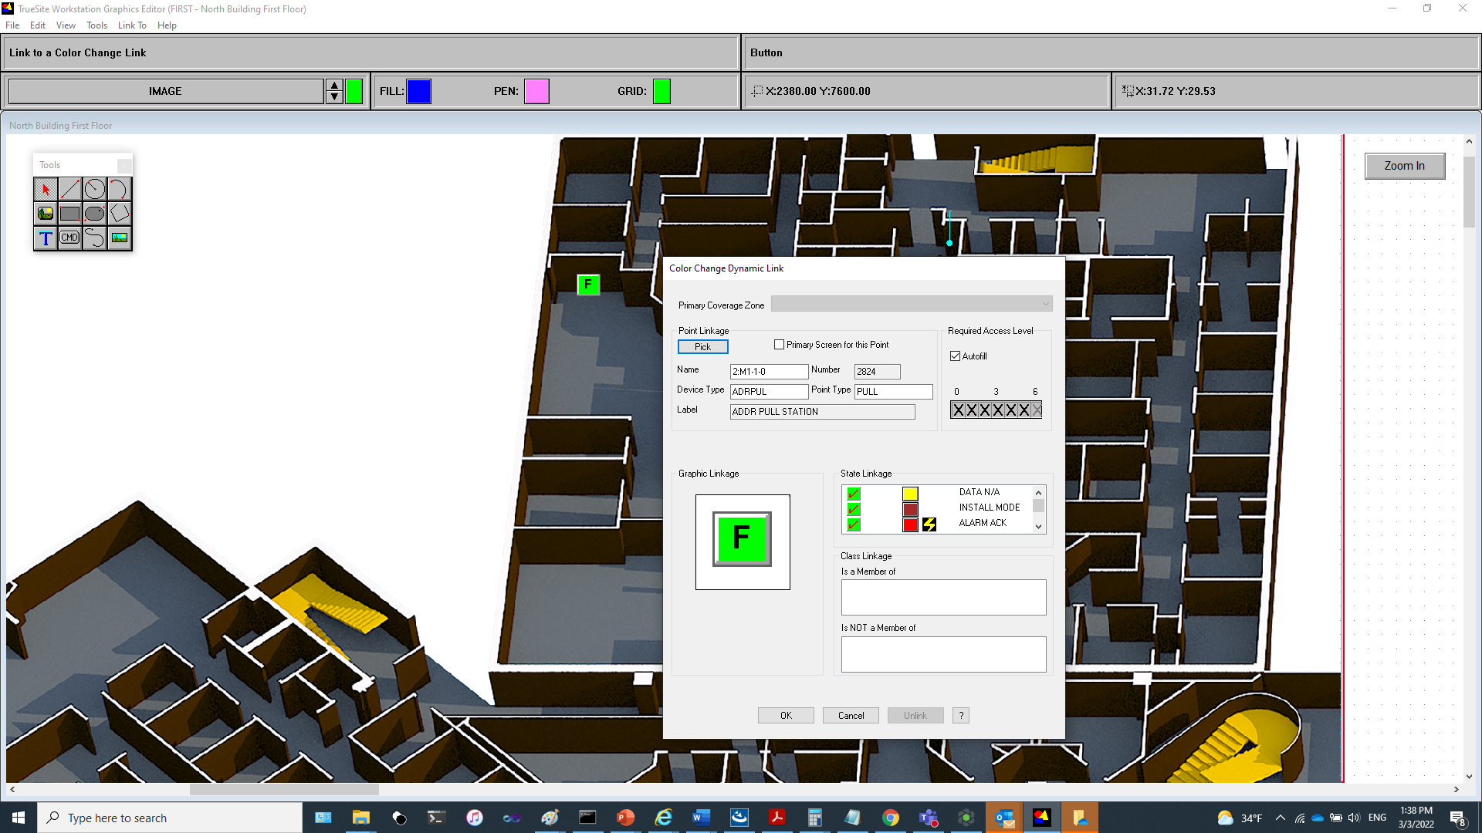
Using Buttons for Icons
When used for Icons, Command Links should not be linked to any command:
Note: it will still be possible to link these types of icons to commands – normally not recommended
The TSW Runtime flashes the colors properly for button icons
Button used for a Color Link

Slide 22
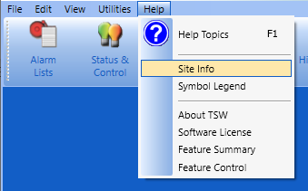
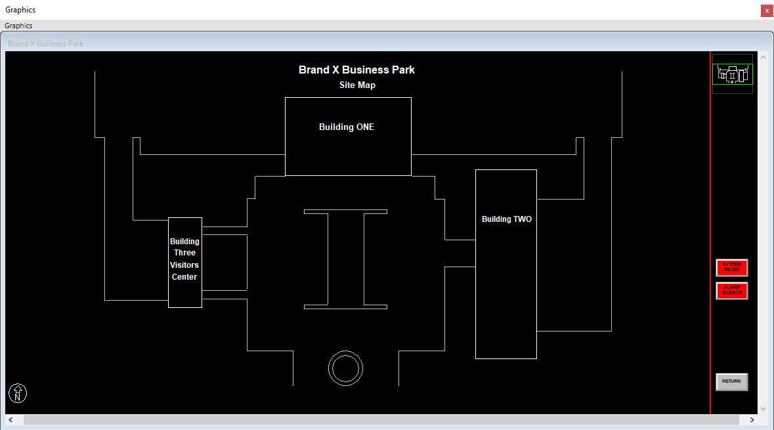
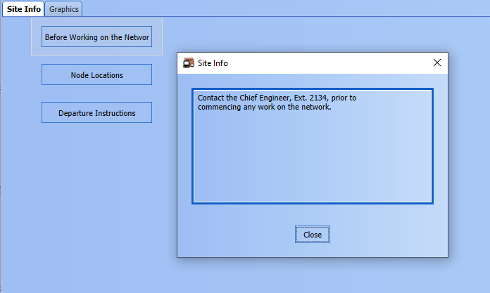
Site Info
The TSW has an option to allow a job to display information when the Site Info menu item is clicked (red arrow)
Either:
The contents of a graphics screen named _SITEINF.WGS
Or an Action Message screen containing the content of System Action Messages 100-105
If both are configured, screen _SITEINF.WGS will be shown
If neither are configured, the menu item will be grayed out
Graphics Site Info Example (_SITEINF.WGS)
System Action Message Site Info Example

Slide 23
Site Info
A new option is available in the TSW Configurator’s System Preferences
When enabled, TSW Runtime will automatically return to/display the Site Info screen when the system returns to Normal and a user is logged in with permission to view the Site Info screen (red arrow)
Default is OFF:
The TSW runtime does not jump to the site info screen when the system returns to normal

Slide 24
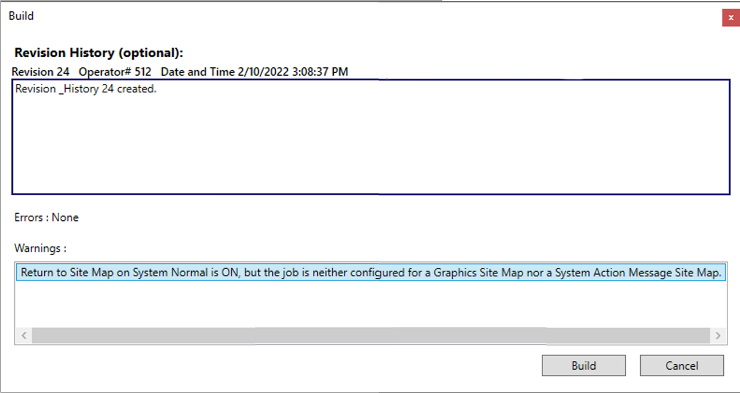
Site Info
If the option is enabled but Site Info is not configured, a warning message will appear during the job build (green arrow)

Slide 25
Site Info
System returns to Normal while the user is not logged in
The TSW runtime does not jump to the site info screen while logged off (applies for both the server and remote clients)
If the system has returned to normal while there is no user logged in; afterwards, when the user logs in and the system is still normal, the TSW runtime shall jump to the site info screen; this applies for both the server and remote clients
Notes:
Software Maintenance Agreement – will get these features automatically

Slide 26
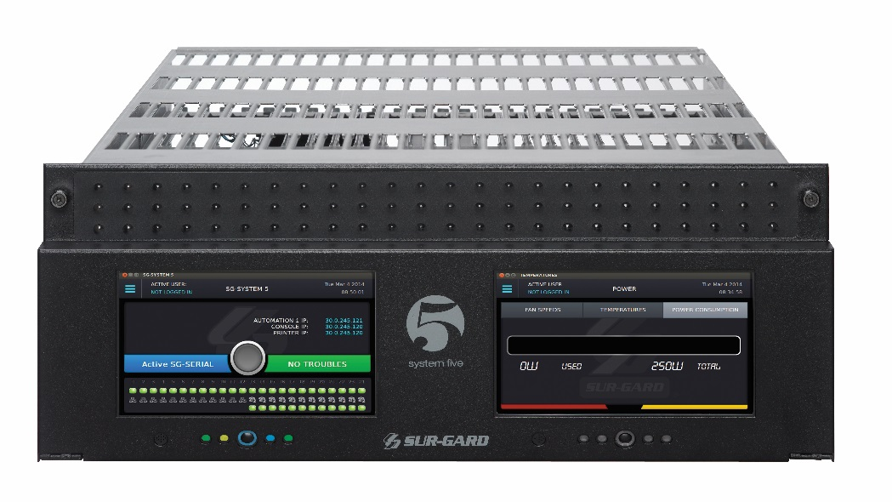
DACR: SIA Level 2 Protocol (SIA2)
The DACR supports the following protocol formats in the TSW:
CID
3/1
4-2
BFSK
SIA level 1
SIA Level 2 (SurGard Receivers only) -- NEW
The DACR models that are supported by the TSW are:
Sur-Gard System I, II, III, IV, V
Bosch D6600, D6100i, D6100IPv6 (aka D6100IPv6-01)
AES Intellinet 7705i, 7705ii

Slide 27
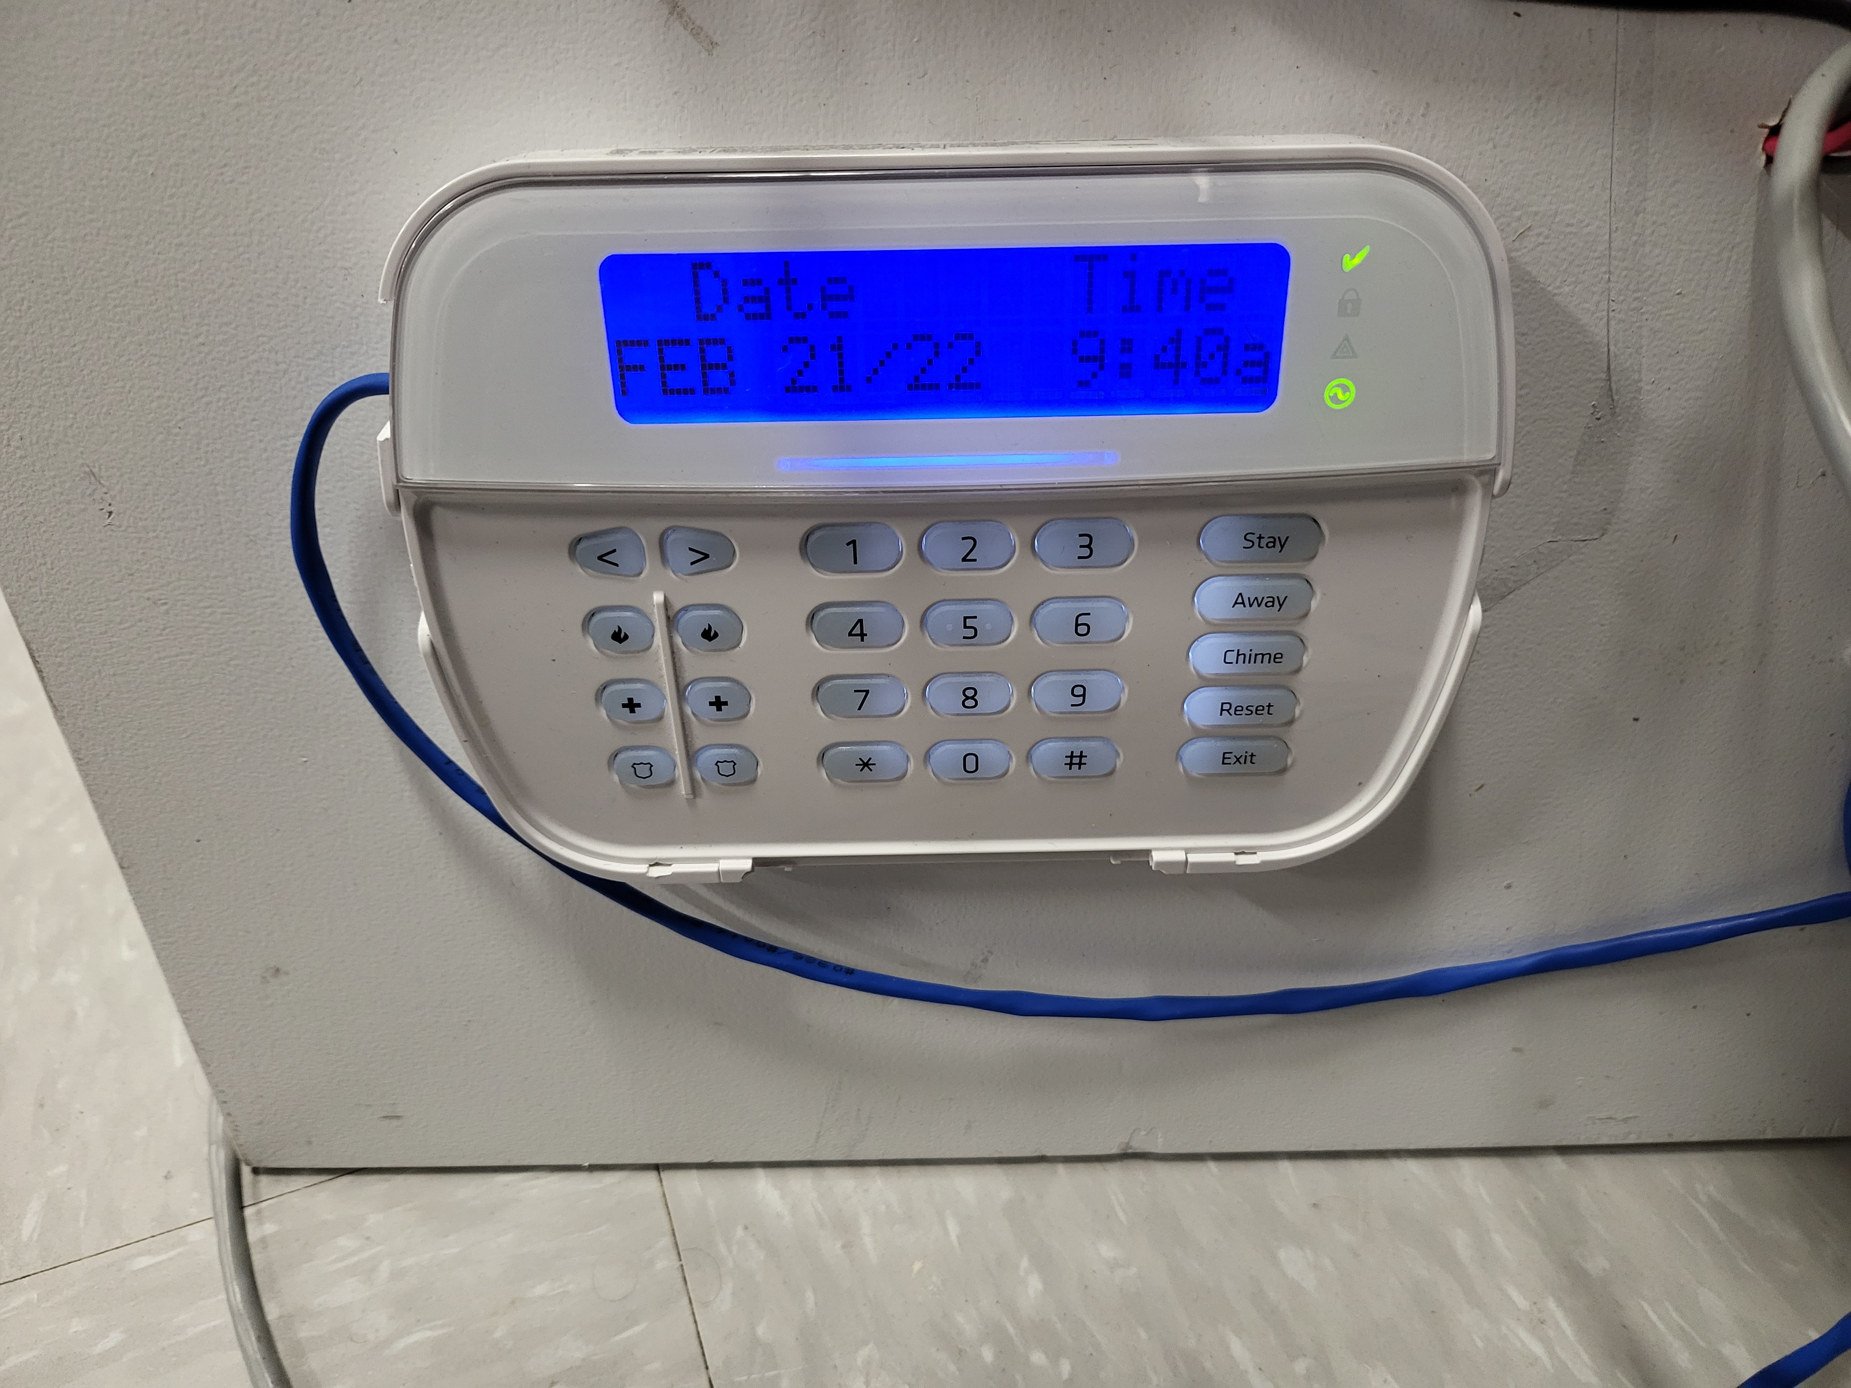
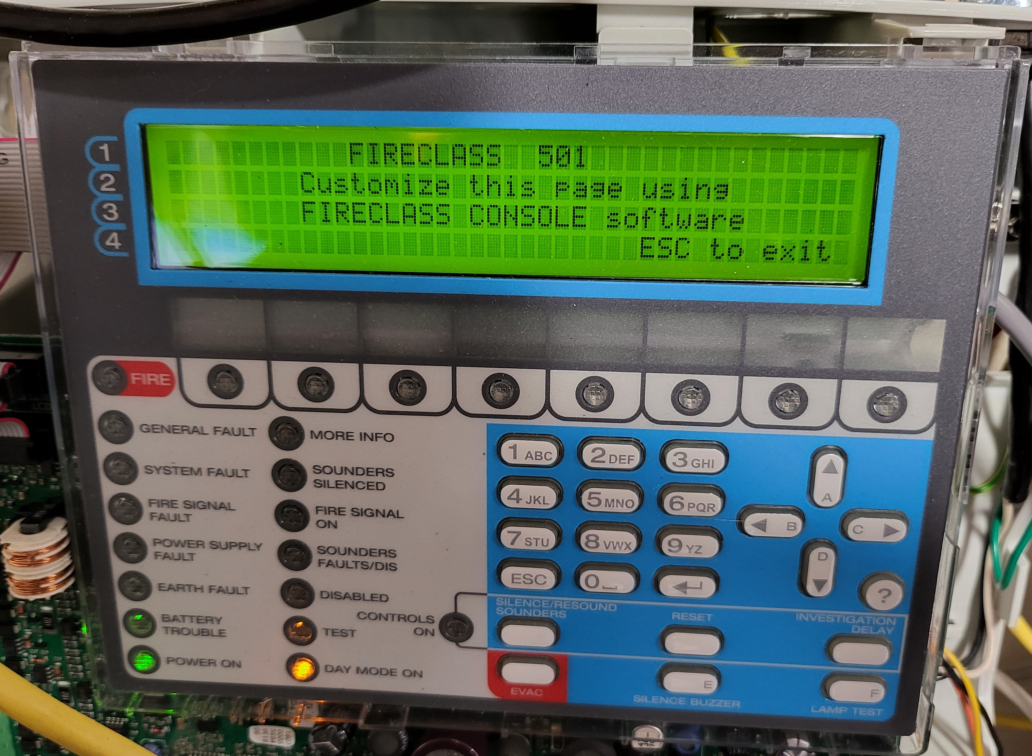
DACR: SIA Level 2 Protocol (SIA2)
JCI Panels that support SIA2:
DSC NEO Panel
FireClass (FC501) Currently Account Level Only

Slide 28
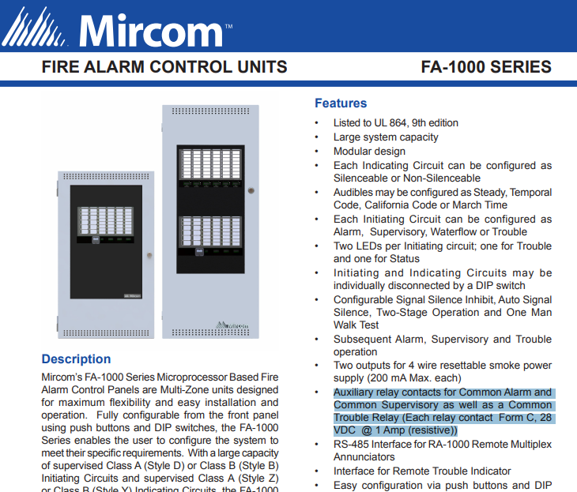
DACR: SIA Level 2 Protocol (SIA2)
SIA2 commonly used in Canada and other regions today (Mircom, etc)

Slide 29
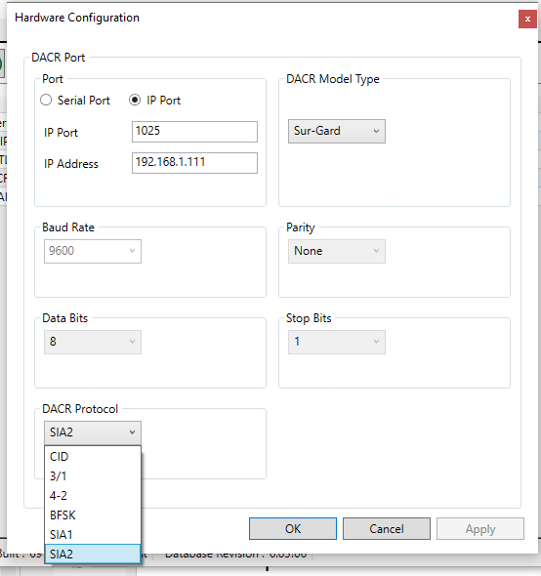
DACR: SIA Level 2 Protocol (SIA2)
Supports incoming TCP/IP connections – only for SurGard Receivers using the SIA 2 protocol
New Hardware Configuration Dialog
DACR Protocol selection
The following options shall be available for the protocol:
CID (default)
3/1
4-2
BFSK
SIA1
SIA2
TSW Configurator Hardware Config dialog for DACR

Slide 30
DACR: SIA Level 2 Protocol (SIA2)
New Hardware Configuration Dialog
Serial Port selection
IP Port for SIA2
Only enabled/available if the DACR Model type is “Sur-Gard”
If SIA2 is selected, then the user is able to select either a Serial Port or “IP Port” for use with TCP/IP. The default port is 1025
If “IP Port” is selected, an “IP Address” text box appears. The default shall be 0.0.0.0. Valid values for each of the four numbers are 0-255
Note: for the System V receiver, “0.0.0.0” means “DHCP Enable” (automatic IP address)
TSW Configurator Hardware Config dialog for DACR

Slide 31
DACR: SIA Level 2 Protocol (SIA2)
New Hardware Configuration Dialog, continued
For all other protocols, only a Serial Port can be selected
If the protocol format is changed after existing DACR points have been added to the job, then a warning dialog shall be displayed:
“Are you sure that you want to change the protocol format? All existing DACR accounts and points from this port shall be deleted from the job”
TSW Configurator Hardware Config dialog for DACR

Slide 32
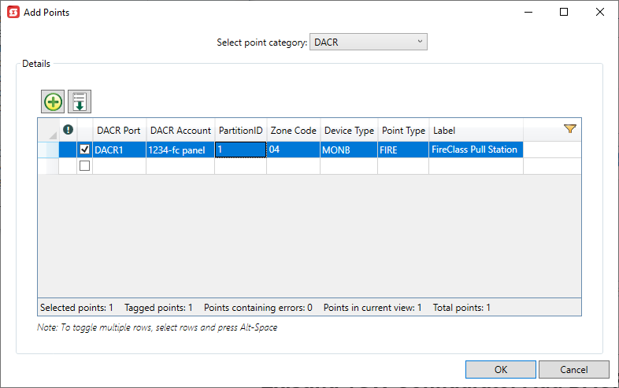
SIA2 Protocol Support
Add DACR Points Dialog
Zone Code (1-4 ASCII numbers)
Partition #: (a single digit 0-9)
DACR Port
DACR Account
Device Type
Point Type
Label
TSW Configurator Add DACR Points dialog

Slide 33
SIA2 Protocol Support
Add DACR Points Dialog
Each Account # / Zone-Code /Partition # combination must be unique; otherwise, Configurator reports an error if there are any duplicate rows
The account number must be 1-16 digits
The Configurator shall report an error if a zone code is empty or more than 4 alphanumeric characters
It shall also be possible to import SIA2 points via a CSV file
If the protocol is SIA2, the csv columns are:
Line #
DACR Account Number
Partition #
Zone Code
Point Type
Point Label
TSW Configurator Add DACR Points dialog

Slide 34
SIA2 Protocol Support
Add DACR Points Dialog, continued
For the Configurator “DACR Point Mapping” report, if the protocol is SIA2, the following column is displayed instead of “CID Group” and “CID Number”:
Zone Code
Partition #
The Configurator Point “More Info” dialog is updated for DACR points if the protocol is SIA2 to show the following instead of “CID Group” and “CID Number”:
Zone Code
Partition #
For both Serial Port SIA2 support, the runtime feature version must be >= 6.03
Note: no feature version checks within the TSW Configurator.
TSW Configurator Add DACR Points dialog

Slide 35
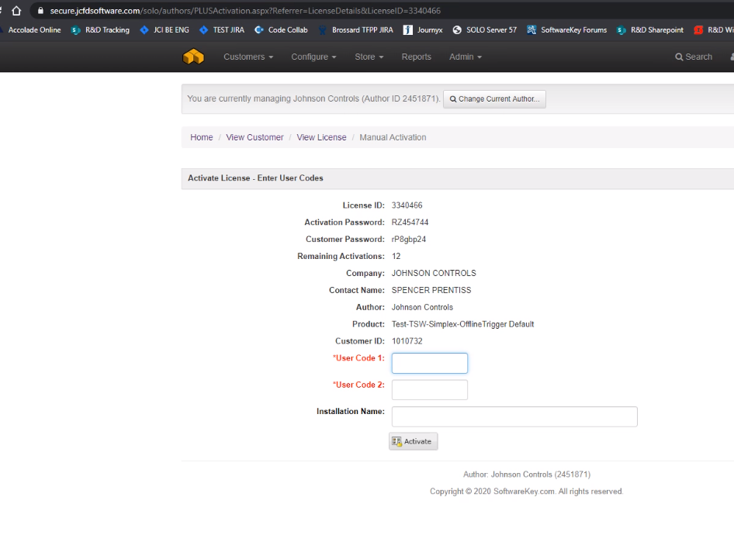
Trigger License Type Support for Secure Customer Sites
Previously, TSW has provided software licenses that can either be activated with an online connection; or for offline sites, by selecting the option to use another computer’s internet connection
This works fine for some customers, where they allow files to both enter and leave the site (e.g. on a thumb drive)
However, we have other customers sites that do not allow any files to leave the site (e.g. secure military sites) and they need “Trigger” licenses
A new license type for “TSW Trigger License” has been added for TSW 6.02.02 (May 2021) for any of our current License types (including TR licenses)
SOLO Server Trigger License Example Screen

Slide 36
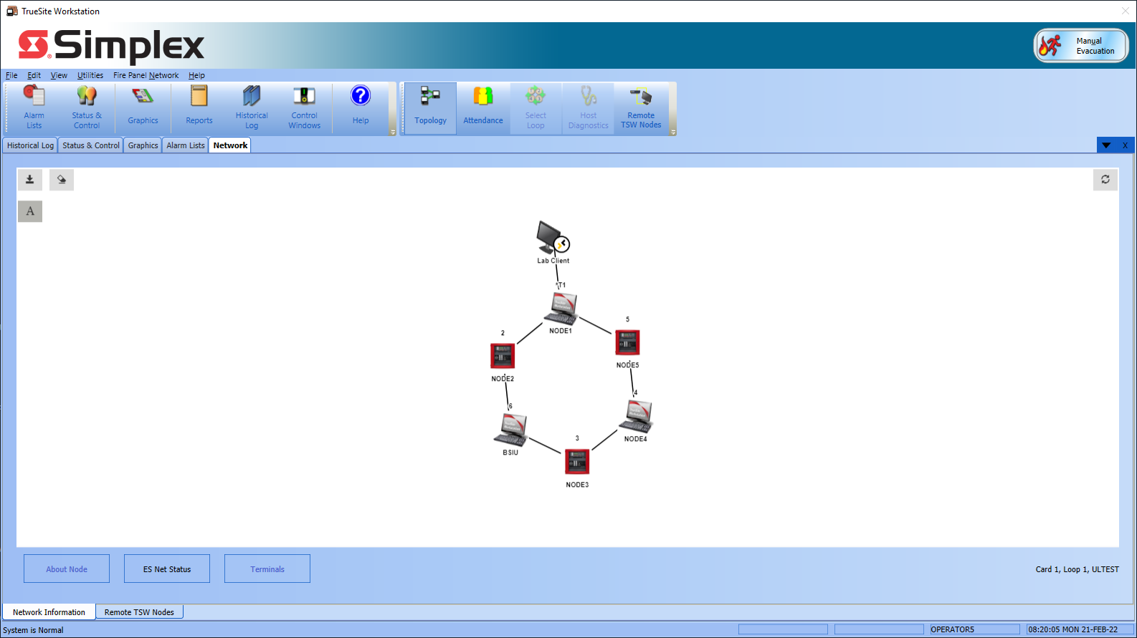
TSW Runtime Topology and Attendance Screens
Previously, the TSW Network Topology and Attendance screens did not show any icons for Supervised Clients
For 6.03, Topology and Attendance screens are updated to include Supervised clients for the local TSW only
Only available for ES Net networks (not for 4120 Networks)
For remote TSW nodes, the Topology and Attendance screens do not show any supervised clients that may be connected to these nodes
Updated TSW Topology Screen (notional) with Supervised Clients

Slide 37
TSW Runtime Topology and Attendance Screens
Third Party Clients are displayed
Neither Unsupervised clients nor built-in clients are displayed
If supervised clients are connected, there are icons displayed with connectors back to the TSW icon on the Topology screen
If supervised clients are disconnected, they display with an “X” over them on the Attendance screen
If supervised clients are disconnected, they are NOT shown on the Topology screen
When a connected supervised remote client shows the topology or attendance screens, an asterisk (*) is displayed next to this client (to identify himself)
Updated TSW Topology Screen (notional) with Supervised Clients

Slide 38
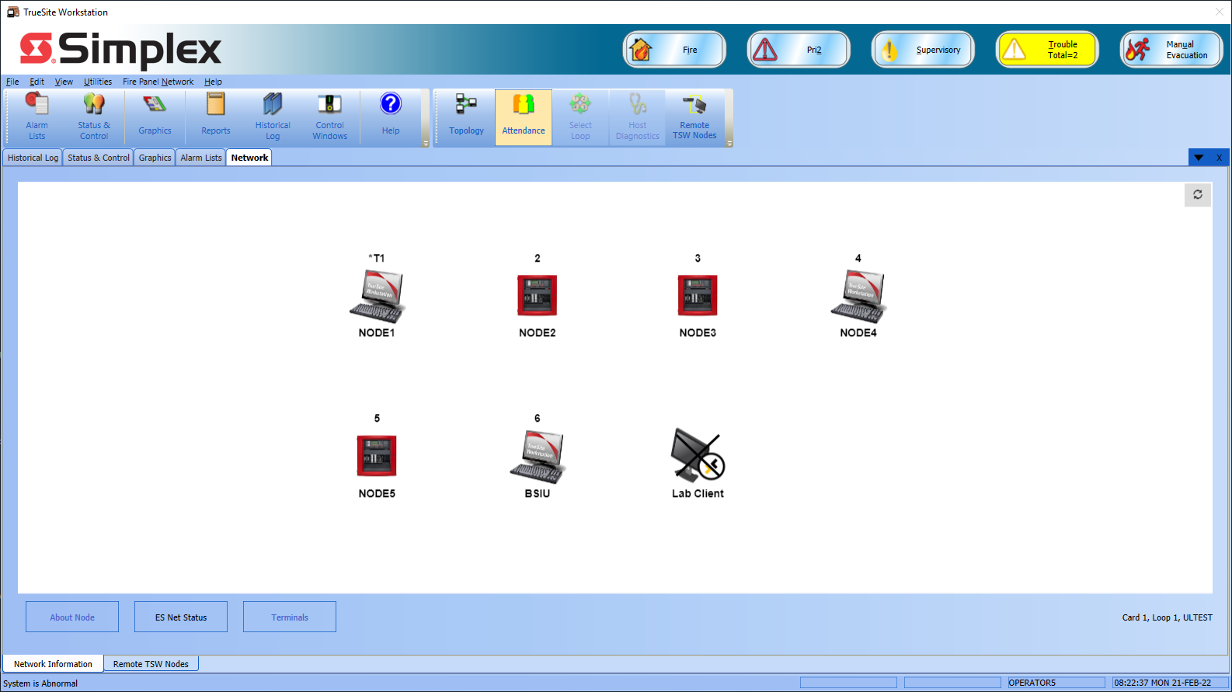
TSW Runtime Topology and Attendance Screens
The Attendance screen is updated with similar changes:
If Supervised clients are not connected, they will be shown with an “X” over them on the Attendance screen
This feature is not supported on TSW version 6.03 or older
Updated Attendance Screen (notional) with disconnected supervised clients

Slide 39
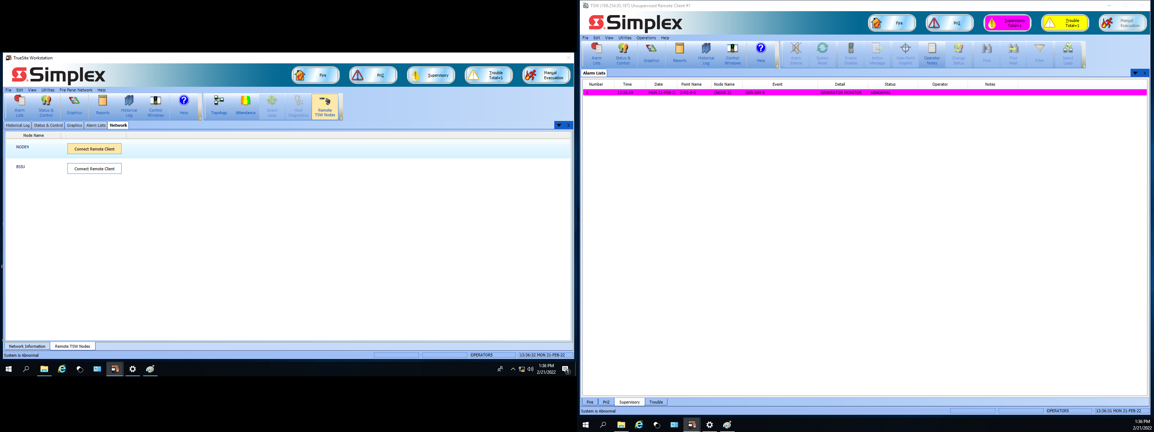
TSW Server Invokes Remote Client Connections to other TSWs on Same Network
For customers with large networks, some sites have multiple TSW’s on the same network and they designate one Central TSW that has multiple monitors.
The main monitor can be used for the Central TSW banner screen; and the other monitors can be used to run remote clients to other TSW’s on the same network – this allows one central location to be able to view the banner screens for multiple locations at once.

Slide 40
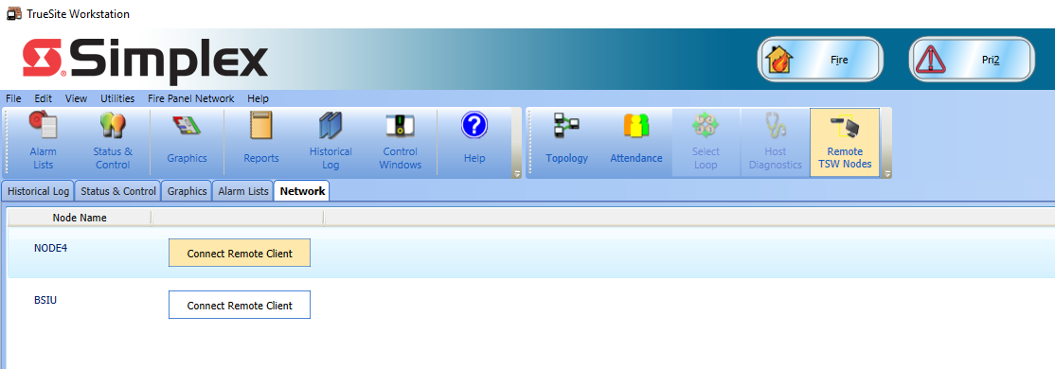
TSW Server Invokes Remote Client Connections to other TSWs on Same Network
For TSW 6.02, we added a new system pseudo point: P214 TSW SYSTEM IS ABNORMAL
This point only turns on if it is made public and the TSW system is not normal (i.e. there are some alarms on the banner)
This pseudo can be useful for similar sites that may have over 250K points (e.g possible job for KSA)
From the central TSW, they can see if any of the remote TSW’s have active alarms; if so, P214 will turn ON, and the operator can invoke a remote client session to that remote TSW to see the details. Note: the job can also be programmed to add an action message for P214 to suggest that the local operator invoke a remote client to this node whenever P214 is ON

Slide 41
TSW Server Invokes Remote Client Connections to other TSWs on Same Network
For TSW 6.03, we have updated the TSW server to make it easier to open remote client connections to remote TSW nodes.
Note: these new features shall not be functional if the TSW feature version is less than 6.03.

Slide 42
New Button on TSW Local Client Network Tab
A new option to the TSW Network tab for: “Remote TSW Nodes”
New sub-tab only available at the TSW server local client (not at remote clients)
New button added to both the “Fire Panel Network” menu and toolbar
The “Remote TSW Node lists all remote TSW nodes on the current network. The local TSW node shall not list itself
Note: if the current loop is a 4120 Loop, the “Remote TSW Nodes” button is disabled or hidden
The “Remote TSW Nodes” sub-tab is hidden if there are no other TSW nodes on the current node

Slide 43
New Button on TSW Local Client Network Tab
Next to each TSW node in the list, there is a button for “Connect Remote Client”
It is still possible to connect to a remote TSW even if this node is not yet on the ESNet Fire network; As long as the node is reachable over TCP/IP
When the user clicks on this button, a remote client session opens up to the selected node
The first time the “Connect Remote Client” button is clicked on for a given node, the TSW prompts for the Node IP address or PC name
On subsequent connections, the address/name is remembered on this server pc, so no prompt will be necessary

Slide 44
Command Line Support
For the next release of TSW, we shall add a new command line parameter -connect:server-name (could be by name or by IP-address) for the Remote Client (TswDesktop.exe) application If this client has already connected to a specified server, then we should have the port/password cached for that client, and the connection should be automatic. Note: TSW currently keeps 3 port/password entries in its local cache.
For the TSW-2022 release, the cache will be increased to store 99 nodes. If not, then the Connect dialog should be displayed and the user will need to enter the port/password. If -connect is used on startup, the current Auto-Connect selections should be ignored. Note: -connect should be ignored if -local is also specified.
The -connect parameter shall be ignored if used on TswServerDesktop,exe . Note: this new command line argument is indented for unsupervised clients; supervised clients should use the existing TSW Auto-Connect options. Also, these new parameters should not interfere with any of the existing TSW command line params (e.g. -screen)
About Network Synchronization

Slide 45
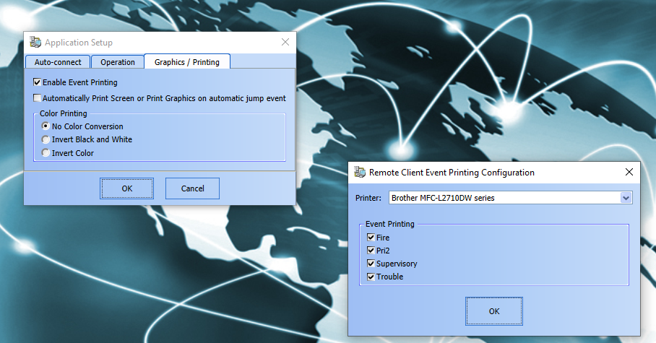
Added Support for Event Printing at Remote Client
Currently, TSW supports event printing at the local client, but not at remote clients
The remote client is updated to allow event printing
The Application Setup dialog for the Remote Client includes a checkbox for “Enable Event Printing”
Note: no change to the local client for this feature
If checkbox is selected, user is prompted to select a printer from list of Windows printers on the current pc. Also includes checkboxes for which events to print (all by default):
Fire
Pri2
Supervisory
Trouble
TSW Remote Client Application Setup dialog

Slide 46
Added Support for Event Printing at Remote Client
The event printer is not supervised at the remote client. However, if the TSW tries to print an event and it fails, the remote client displays an error message “Error: unable to print event – please check printer connection”
There is a checkbox on this dialog for “Turn off event printing for this client”
This dialog only appears one at a time (never more than one instance of this dialog)
Note: for supervised clients, a UL Listed printer is required: 4190-9027 (Epson LQ-590)
TSW Remote Client Application Setup dialog

Slide 47
TSW Runtime Language Support
Language support
Continue to provide Localization kit that allows TSW Runtime to be translated into any foreign language (including French)
Now support for these additional languages
Traditional Chinese*
All languages now supported include:
English
Canadian French
LATAM Spanish
Brazilian Portuguese
Arabic
Traditional Chinese
* Contact Tech Support for the TSW Chinese Customer Kit (same as other languages)

Slide 48
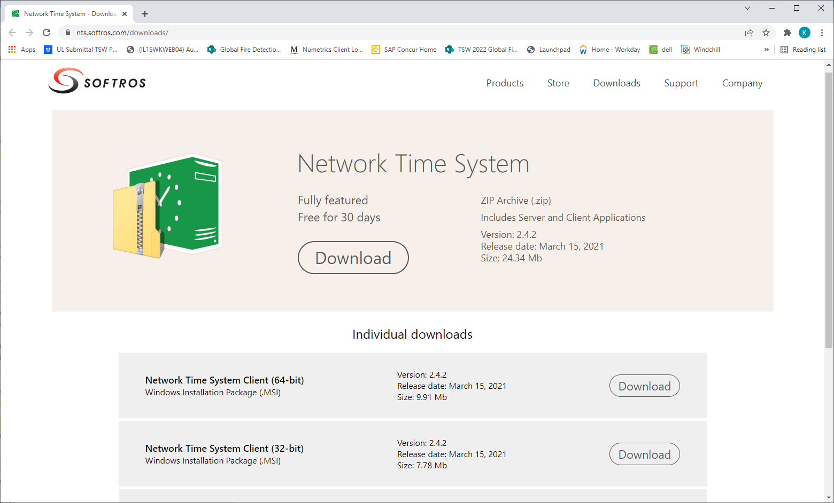
Support for TSW using an NTP Time Server on the same PC
TSW can now be used with an NTP time server on the same PC:
Softros Network Time System
If a site needs to see the GUI for Softros, they will need to run the TSW in non-captive mode; and if they need to see both at the same time, they can use a second monitor.
Note: The TSW node should be set as the Master Timekeeper on the Fire Network in order to properly utilize this
SQA has validated that TSW and Softros can run in parallel
No issues with UL Listings

Slide 49
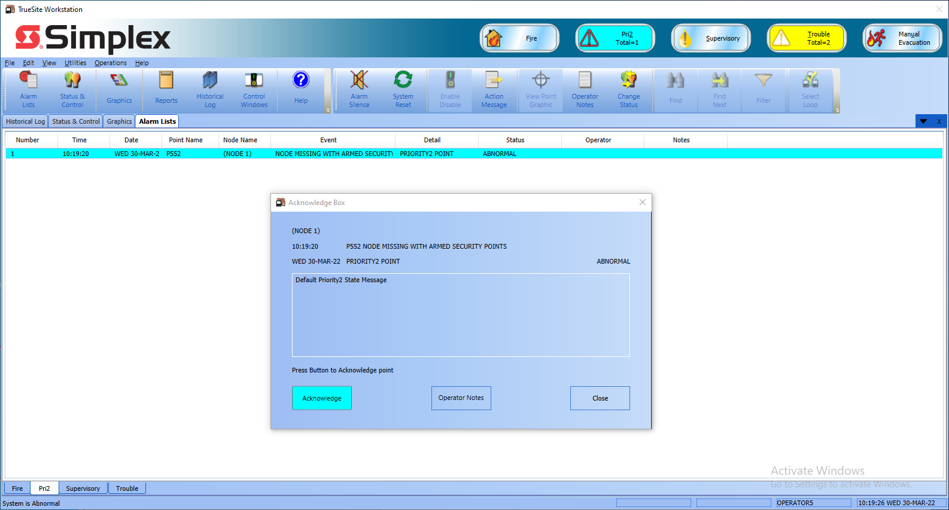
UL-2610 support added for TSW 6.03.01
UL 2610 Compliance (Standard for Commercial Premises Security Alarm Units and Systems)
UL 2610 replaces previous standards: UL 1610 and UL 1074
If a TSW System contains any ARMED Security/Pri2 Points from an external node and TSW has a loss of communication with that node, the TSW must annunciate a Priority2 Alarm
See the TSW Configurator Manual (0579-844) for details on how to properly configure the TSW System for UL2610 Compliance

